Slide 1
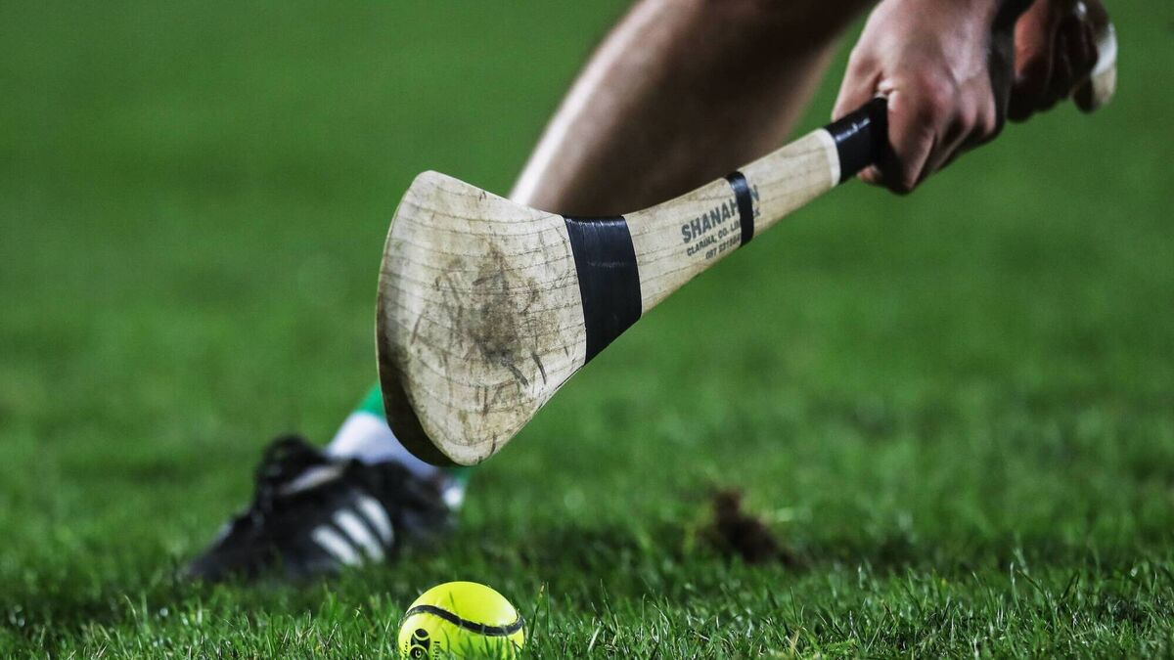
Smart Hurley
By Joshua Geoghegan

Slide 2
Project Overview
The Smart Hurley project aims to develop a small, wireless sensing device that can detect when a hurley strikes a sliotar and send this information to a smartphone app via Bluetooth.
The goal is to gamify hurling practice for children by tracking daily strikes and creating interactive training challenges like maintaining streaks in learning apps like Duolingo

Slide 3
Project objectives
Design and build a hurley-mounted wireless sensor to detect strikes.
Use an IMU (BMI160) to measure swing motion and orientation.
Use an piezoelectric sensor to detect physical contact/impact events.
Transmit data wirelessly to a mobile app using Bluetooth Low Energy (BLE).
Log and visualize strike counts and activity levels.
Evaluate the system’s accuracy and reliability during real strikes.

Slide 4
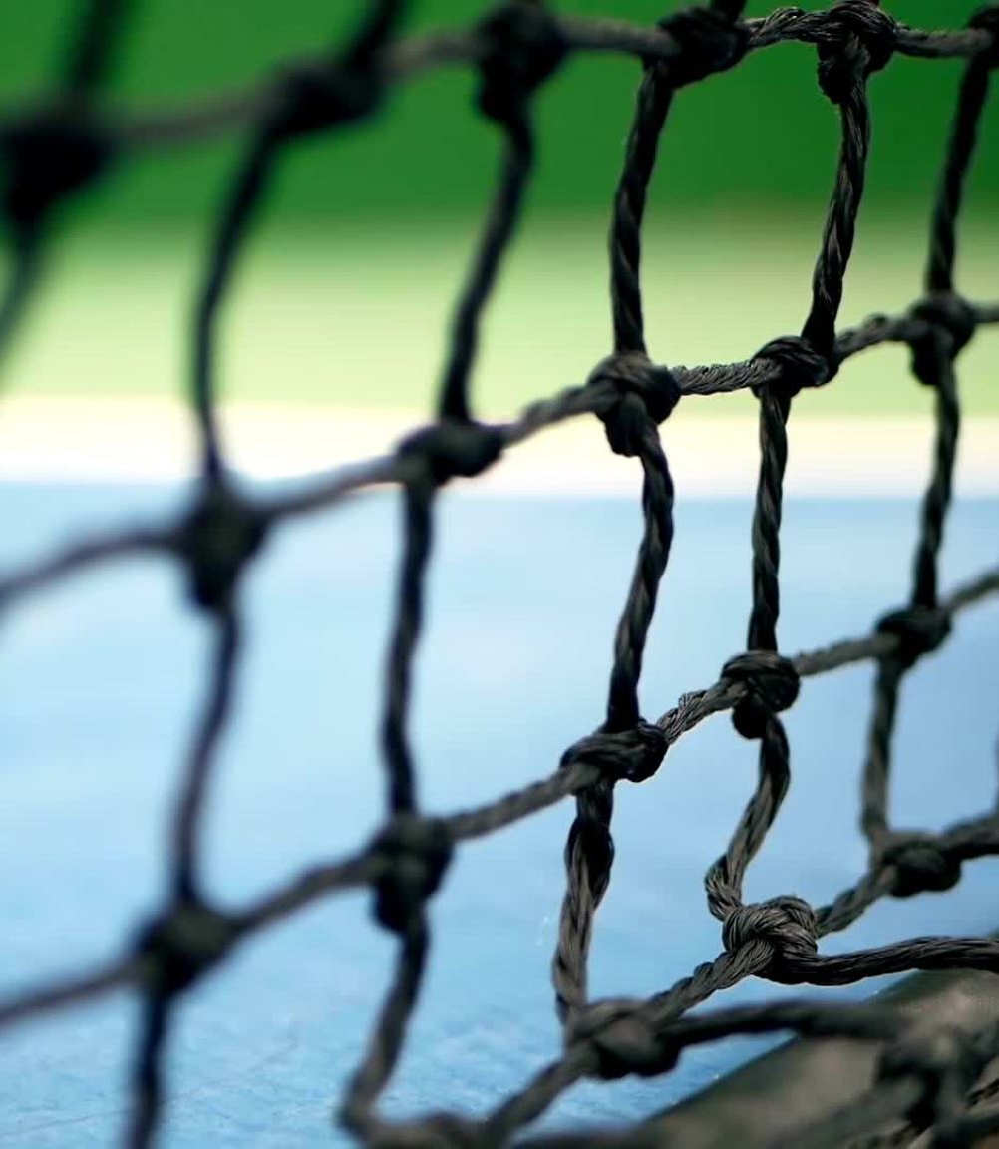
Background Research
Problem: Young players rarely practice between sessions.
Idea: Gamify solo practice using feedback from real hurley strikes.
Related Work:
Smart tennis rackets (Babolat, Zepp) use IMUs for swing tracking.
Gap: No low-cost, child-friendly system designed for hurling, integrating both impact sensing and gamified feedback.

Slide 5
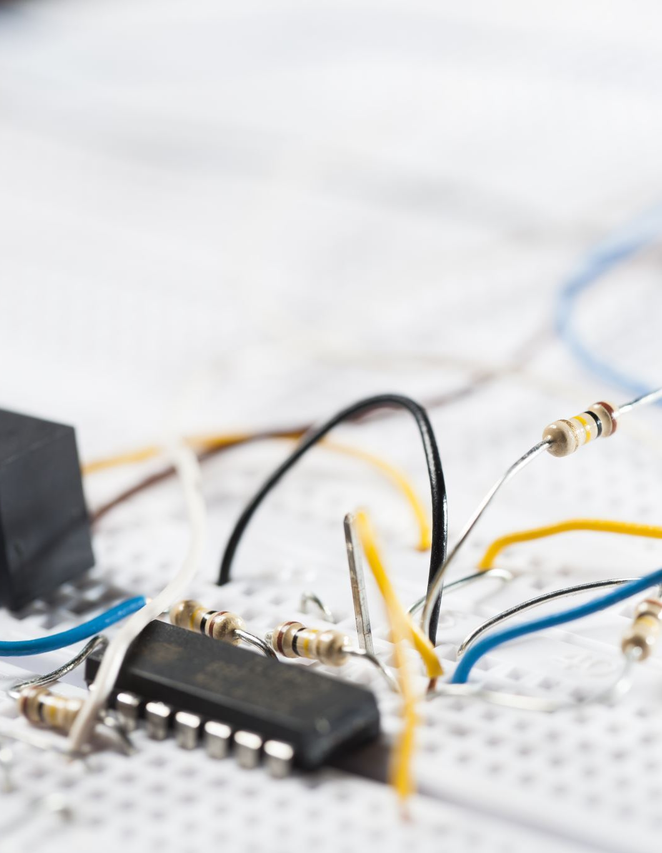
Sensor Data & Processing
Data Capture:
The Smart Hurley uses a piezoelectric sensor (Murata 7BB-20-6L0) and a BMI160 IMU mounted on the handle.
Both sensors are sampled by the ESP32 at 100–200 Hz, ensuring high-resolution capture of each swing.
The piezo detects sharp vibrations from impacts, while the IMU captures swing acceleration, rotation, and orientation.
Filtering & Signal Conditioning:
A high-pass filter isolates the high-frequency vibration spikes from the piezo, removing slower hand or grip motions.
An exponential moving average smooths the IMU data, reducing noise while preserving meaningful swing patterns.
This combination of filtering ensures that both sensors provide clean, reliable signals for strike detection.

Slide 6

Strike Detection & Wireless Logging
Strike Detection Algorithm:
A strike is confirmed when a piezo voltage spike coincides with an IMU acceleration peak within a short time window (~50 ms).
Thresholds and timing logic reduce false positives caused by casual movements or vibrations.
Each confirmed strike is time-stamped and stored locally on the ESP32.
Wireless Logging:
Strike data including count, timestamp and relative intensity is transmitted to a paired smartphone via Bluetooth Low Energy using GATT notifications
Logged data can later be exported for performance analysis and visualization in a custom Android app, supporting gamified feedback like streaks and achievements.

Slide 7
Testing & Evaluation
Testing Methods:
Strike Detection Accuracy: Compare sensor detection with manually counted strikes.
False Positives/Negatives: Test swings without hitting the ball to check for misdetections.
Wireless Performance: Check BLE connectivity and latency over typical distances.
Expected Outcomes:
Reliable strike detection with minimal false positives.
Real-time BLE transmission to the smartphone.
Data sufficient for gamified feedback and performance analysis.

Slide 8
Anticipated Challenges
Strike Detection Accuracy: Synchronizing piezo spikes with IMU acceleration to avoid false positives.
Signal Conditioning: Ensuring piezo output is safe for ADC input and clearly distinguishable from noise.
Wireless Reliability: Maintaining stable BLE connection to the app during fast swings.
Housing & Mounting: Designing a durable, lightweight casing that fits the hurley handle without affecting grip or balance.
Sensor Placement: Determining optimal piezo and IMU locations for consistent detection across different players.

Slide 9
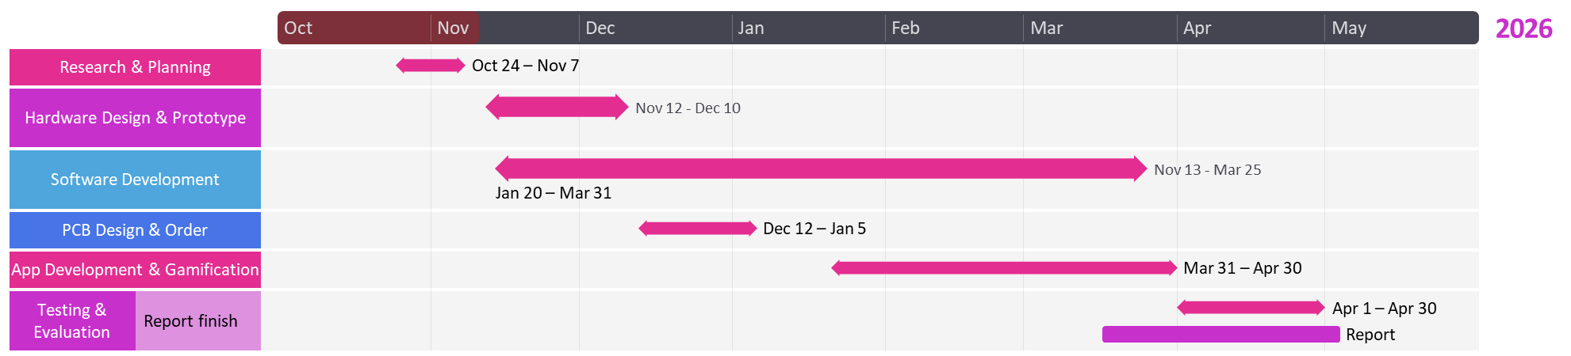
Timeline- gnatt Chart

Slide 10

Thank you for listening

